Slide 1

White Box Testing

Slide 2
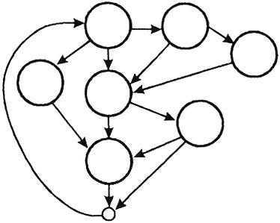
White Box Testing
White box testing is a strategy in which testing is based on the internal paths, structure, and implementation of the software under test (SUT)

Slide 3
White Box Testing - Applicability
White box testing can be applied at all levels of system development
Unit
Integration
System
Generally white box testing is equated with
unit testing performed by developers

Slide 4
White Box Testing
Control flow testing
Data flow testing

Slide 5
Control Flow Testing
Based on the flow of control in the program
Logical decisions
Loops
Execution paths
Coverage metrics
Measure of how complete the test cases are
Not the same as how good they are!
Boolean AND, OR, XOR
Which test case is good?

Slide 6
Control Flow Graphs
Given a program written in an imperative programming language, its program graph is a directed graph in which nodes are statement fragments, and edges represent flow of control

Slide 7
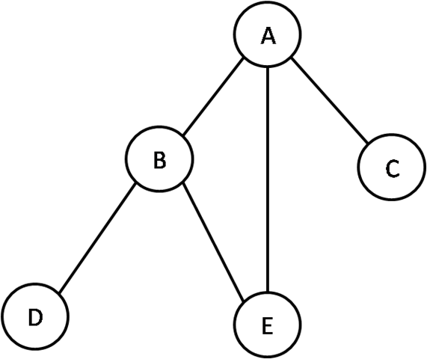
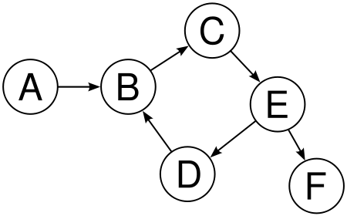
Directed Graph
Undirected Graph

Slide 8
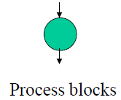
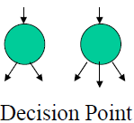
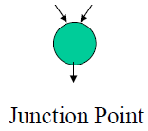
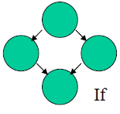
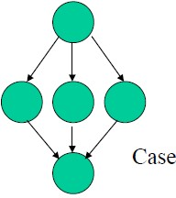

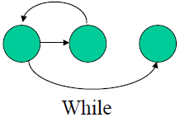
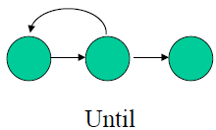
Control Flow Graphs

Slide 9
Code Coverage (Test Coverage Metrics)
Levels of Coverage:
Statement/Line/Basic block/Segment Coverage
Decision (Branch) Coverage
Condition Coverage
Multiple Condition Coverage
Decision/Condition Coverage
Loop Coverage
Path Coverage

Slide 10
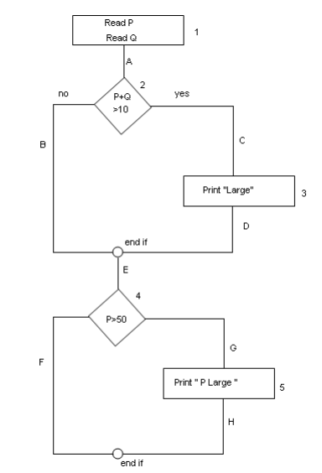
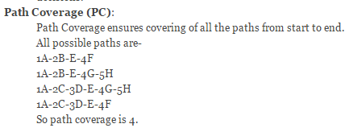
Example:
Read P
Read Q
IF P+Q > 100 THEN
Print “Large”
ENDIF
If P > 50 THEN
Print “P Large”
ENDIF

Slide 11
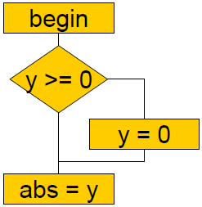
Statement Coverage
Execute each statement at least once
Begin
if ( y >= 0)
then y = 0; abs = y;
end;
yes
no

Slide 12
Statement Coverage
Execute each statement at least once
Begin
if ( y >= 0)
then y = 0; abs = y;
end;
yes
no
test case-1(yes):
input: y = ?
expected result: ?
actual result: ?
Write test cases to execute every
statement!

Slide 13
Statement Coverage
Execute each statement at least once
Begin
if ( y >= 0)
then y = 0; abs = y;
end;
100% statement coverage!
yes
no
test case-1(yes):
input: y = ?
expected result: ?
actual result: ?
test case-1(yes):
input: y = 0
expected result: 0
actual result: 0

Slide 14

What is wrong with line coverage
Software developers and testers commonly use line coverage because of its simplicity and availability in object code instrumentation technology.
Of all the structural coverage criteria, line coverage is the weakest, indicating the fewest number of test cases.
Bugs can easily occur in the cases that line coverage
cannot see.
The most significant shortcoming of line coverage is that it fails to measure whether you test simple if statements with a false decision outcome.
Experts generally recommend to only use line coverage if nothing else is available.

Slide 15
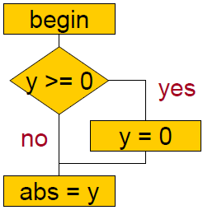
Decision (Branch) Coverage
Execute each edge in the CFG at least once
Begin
if ( y >= 0)
then y = 0;
abs = y;
end;

Slide 16
Decision (Branch) Coverage
Execute each edge in the CFG at least once
Begin
if ( y >= 0)
then y = 0;
abs = y;
end;
test case-1(yes):
input: y = ?
expected result: ?
actual result: ?
test case-2(no): input: y = expected result: actual result:
?
?
?

Slide 17
Decision (Branch) Coverage
Execute each edge in the CFG at least once
Begin
if ( y >= 0)
then y = 0;
abs = y;
end;
test case-1(yes):
input: y = 0
expected result: 0
actual result: 0
test case-2(no): input: y = expected result: actual result:
-5
5
-5

Slide 18
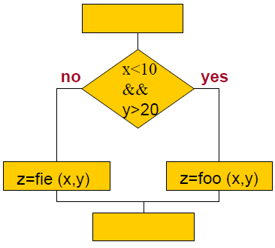
Condition Coverage
Each condition in each decision must be both true and false
Begin
if ( x < 10 && y > 20) {
z = foo (x, y);
else
z =fie (x, y);
}
end;

Slide 19
Condition Coverage
Each condition in each decision must be both true and false
Begin
if ( x < 10 && y > 20) {
z = foo (x, y);
else
z =fie (x, y);
}
end;
test case-1(T,F):
input: x = ?; y = ?
expected result: ?
actual result: ?
test case-2(F,T): input: x = ?; y = expected result: actual result:
?
?
?

Slide 20
Condition Coverage
Each condition in each decision must be both true and false
Begin
if ( x < 10 && y > 20) {
z = foo (x, y);
else
z =fie (x, y);
}
end;
test case-1(T,F):
▪ input: x = -4; y = 12
expected result: ?
actual result: ?
test case-2(F,T): input: x = 12; y =30 expected result: ?
actual result: ?

Slide 21
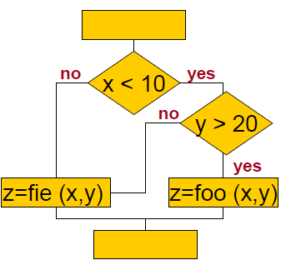
Multiple Condition Coverage
All combinations of conditions must be executed in each decision Begin
if ( x < 10 && y > 20) {
z = foo (x, y);
else
z =fie (x, y);
}
end;
x < ? y > ? --------------------------------------------
test-case-1: | T | T
test-case:2 | T | F
test-case-3: | F | T
test-case-4: | F | F

Slide 22
Multiple Condition Coverage
All combinations of conditions must be executed in each decision Begin
if ( x < 10 && y > 20) {
z = foo (x, y);
else
z =fie (x, y);
}
end;
x < 10 y > 20 --------------------------------------------
test-case-1: | T | T
test-case:2 | T | F
test-case-3: | F | T
test-case-4: | F | F

Slide 23
Decision/Condition Coverage
Satisfy both condition and decision coverage
Begin
if ( x < 10 && y > 20) {
z = foo (x, y);
else
z =fie (x, y);
}
end;
test case-1(T, T, yes):
input: x = ?; y = ?
expected result: ?
actual result: ?
test case-2(F, F, No):
input: x = ?; y = ?
expected result: ?
actual result: ?

Slide 24
Decision/Condition Coverage
Satisfy both condition and decision coverage
Begin
if ( x < 10 && y > 20) {
z = foo (x, y);
else
z =fie (x, y);
}
end;
test case-1(T, T, yes):
▪ input: x = -4; y = 30
expected result: ?
actual result: ?
test case-2(F, F, No): input: x = 12; y = 12 expected result: ?
actual result: ?

Slide 25


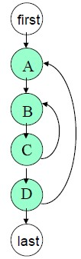
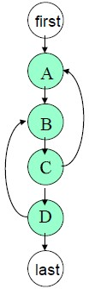

Loop Coverage
Simple
Concatenated
Nested
Unstructured

Slide 26
Loop Coverage
Simple
Concatenated
Nested
Unstructured

Slide 27
Loop Coverage
Simple loops :
Skip the loop entirely
Only one pass through the loop
Two passes through the loop
m passes through the loop when m < n
m: small number representing a typical loop value n: maximum number of allowable passes through the loop
n-1, n, n+1passes through the loop

Slide 28
Loop Coverage
Nested loops:
Start at the innermost loop, set all other loops to minimum value.
Conduct Simple loop test for innermost loop Add other tests for out-of-range or excluded values.
Continue until all loops have been tested.
.

Slide 29
Loop Coverage
Concatenated loops:
If each of the loops is independent of the other, use Simple loops approach
If the loops are concatenated and dependent ( counter for loop 1 is used as the initial value for loop 2) then use Nested loop approach.

Slide 30
Loop Coverage
Unstructured loops:
Whenever possible, this class of loops should be redesigned to reflect the use of the structured programming constructs.

Slide 31
Path Coverage
A path is a sequence of branches, or conditions
A path corresponds to a test case, or a set of inputs
In code coverage testing, branches have more importance than the blocks they connect
Bugs are often sensitive to branches and
conditions

Slide 32
Independent paths
An independent path is any path through the program that introduces at least one new set of processing statements or a new condition
When stated in terms of a flow graph, an independent path must move along at least one edge that has not been traversed before the path is defined

Slide 33
What is Cyclomatic Complexity?
Cyclomatic complexity is a source code complexity measurement that is being correlated to a number of coding errors. It is calculated by developing a Control Flow Graph of the code that measures the number of linearly-independent paths through a program module.
Lower the Program's cyclomatic complexity, lower the risk to modify and easier to understand. It can be represented using the below formula:

Slide 34
Cyclomatic Complexity
Cyclomatic Complexity is a software metric that provides a Quantitative measure of the logical complexity of a program
When used in context of the basis path testing method, the value computed for cyclomatic complexity defines the number of independent paths in the basis set of a program and provides us with an upper bound for the number of tests that must be conducted to ensure that all statements have been executed at least once
Mathematical values involves

Slide 35
Computation of Cyclomatic Complexity
Cyclomatic complexity has a foundation in graph theory and is computed in the following ways:
Cyclomatic complexity V(G),for a flow graph,
G, is defined as:
V(G) = E – N + 2P
E: No. of edges
N: No. of nodes
P: No. of disconnected parts of the graph

Slide 36
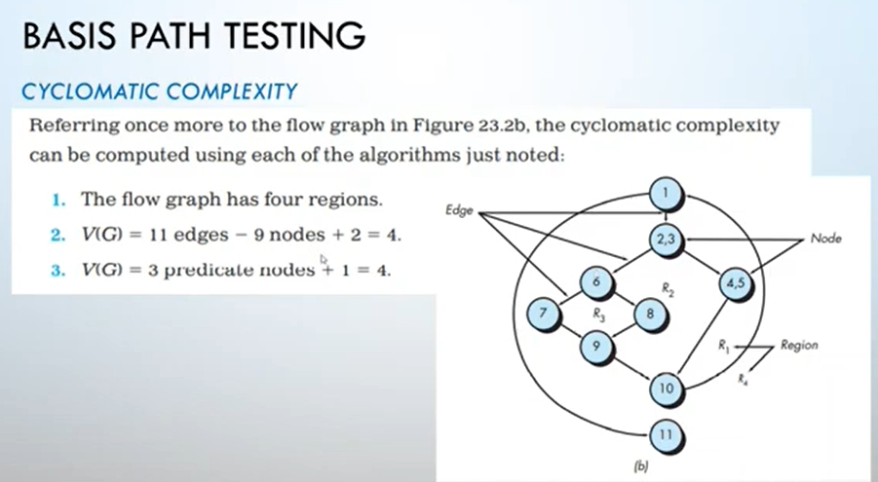

Slide 37
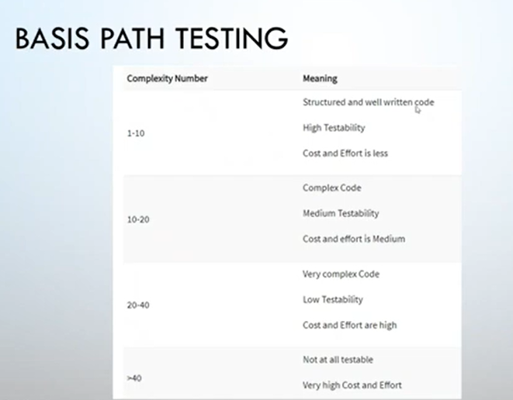

Slide 38
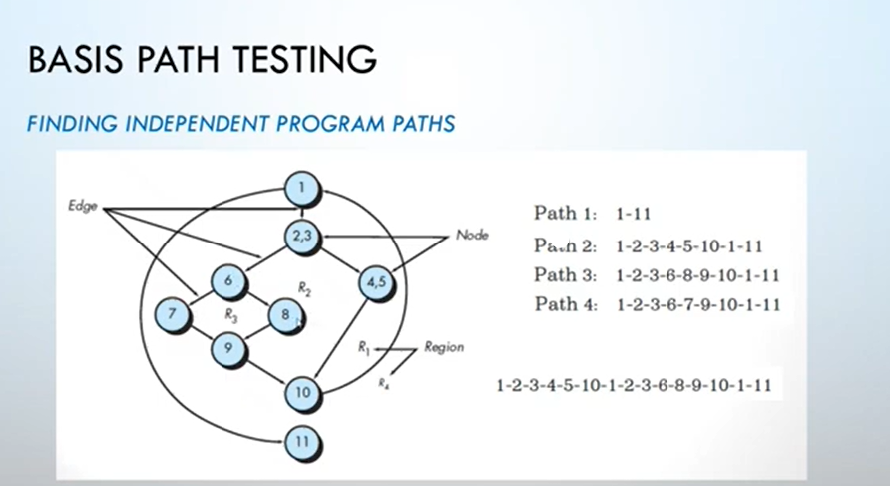

Slide 39
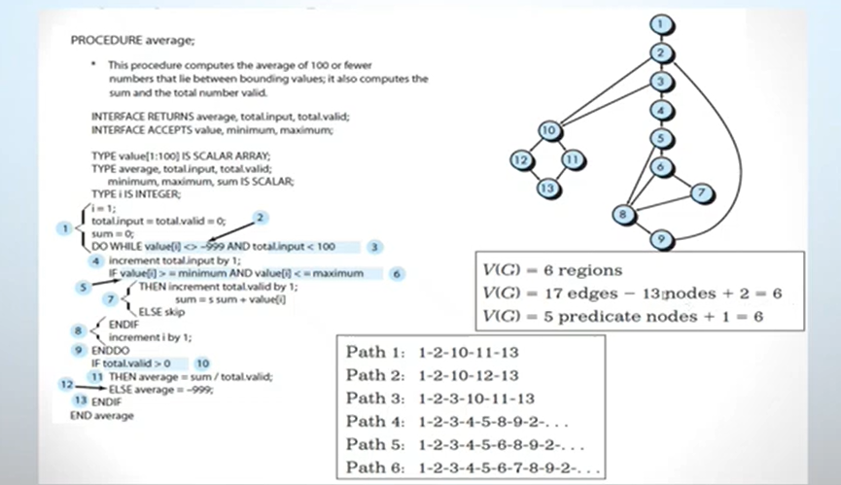

Slide 40
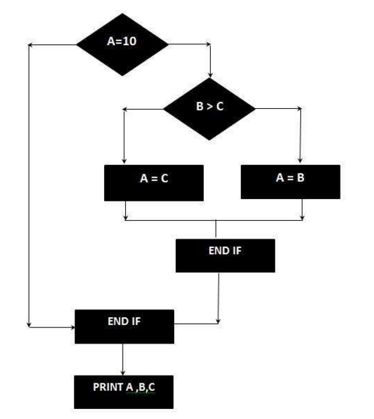
IF A = 10 THEN
IF B > C THEN
A = B
ELSE
A = C
ENDIF
ENDIF
Print A Print B Print C
V(G) = E – N + 2P
8 - 7 + 2 = 3

Slide 41
Computation of Cyclomatic Complexity
Cyclomatic complexity has a foundation in graph theory and is computed in the following ways:
Cyclomatic complexity V(G),for a flow graph,
G, is defined as:
V(G) = b + 1
b: number of binary decision

Slide 42
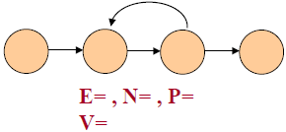
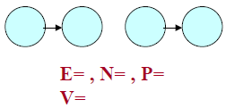
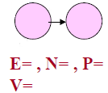
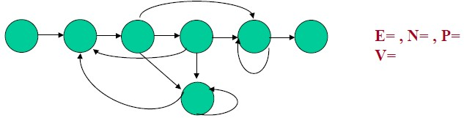
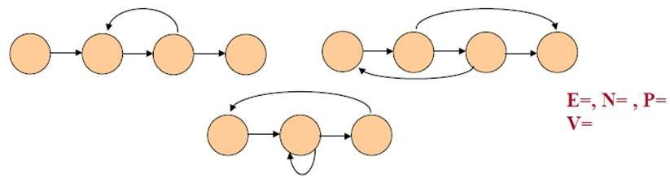
Computation of Cyclomatic Complexity
1 – 2 + 2 = 1
4 – 4 + 2 = 2
2 – 4 + 2 * 2 = 2
12 – 7 + 2 = 7
13-11+2*3= 8

Slide 43
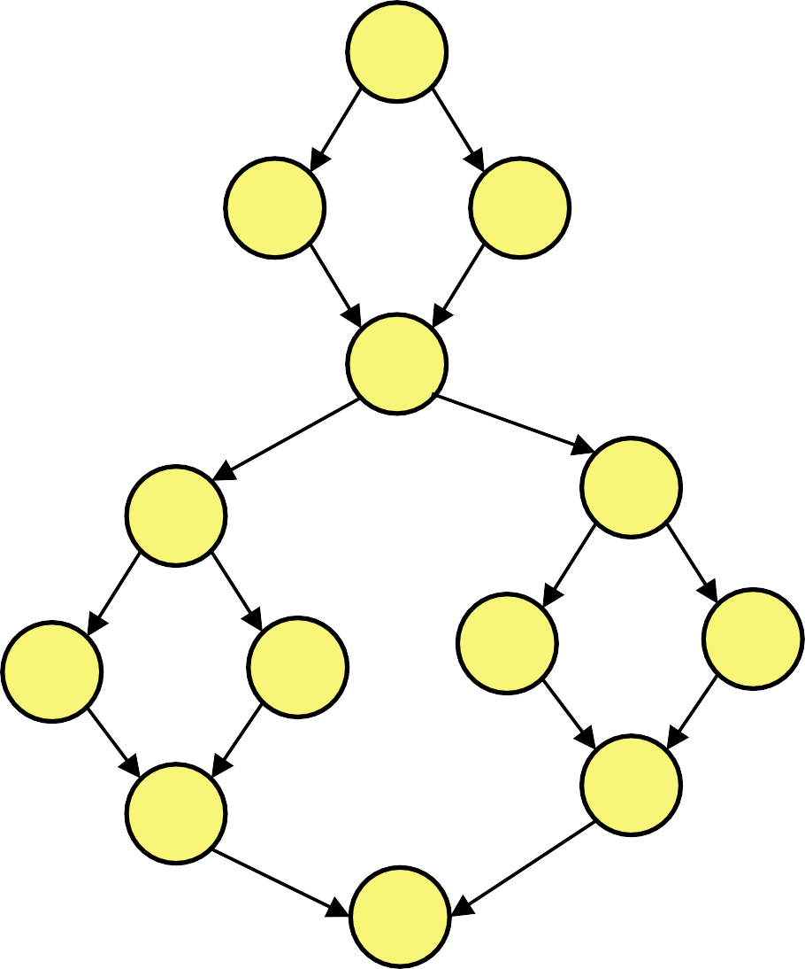
Computation of Cyclomatic Complexity
A
V(G) = E – N + 2P
E = ?
N = ?
P = ? V(G) = ?
B
C
D
E
F
I
J
V(G) = b + 1
b = ?
V(G) = ?
G
H
K
L
M

Slide 44
Computation of Cyclomatic Complexity
A
V(G) = E – N + 2P
E = 16
N = 13
P = 1
V(G) = 5
B
C
D
E
F
I
J
V(G) = b + 1
b = 4
V(G) = ?
G
H
K
L
M

Slide 45
Basis Path Testing
Derive the control flow graph
Compute the graph’s Cyclomatic Complexity of the resultant flow graph
Determine a basis set of linearly independent paths
Create a test case for each basis path
Execute these tests

Slide 46
McCabe’s Baseline Method
Pick a “baseline” path. This path should be a “normal case” program execution. McCabe advises: choose a path with as many decision as possible.
To choose the next path, change the outcome of the first decision along the baseline path while keeping the maximum number of other decisions the same as the baseline path.
To generate the third path, begin again with the baseline but vary the second decision rather than the first.
Repeat the 3 for other paths until all decision along baseline path have been flipped.
Now proceed to the second path, flipping its decisions, one by one until the basis path set is completed.

Slide 47
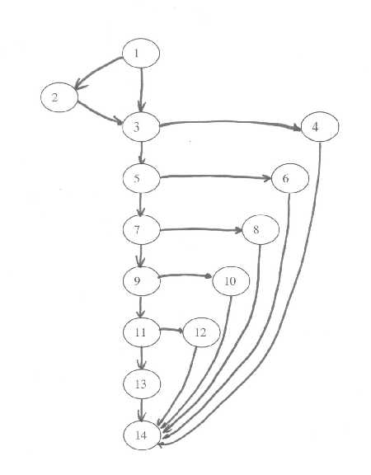
McCabe’s Baseline Method

Slide 48
McCabe’s Baseline Method
Determine the cyclomatic complexity of the flow graph.
V(G) = E - N + 2 = 19 - 14 + 2 = 7
V(G) = B+1
= 6+1
= 7
This tells us the upper bound on the size of the basis set. That is, it gives us the number of independent paths we need to find.

Slide 49
McCabe’s Baseline Method
Determine the basis set of independent paths.
Path 1: 1 - 2 - 3 - 5 - 7 - 9 - 11 - 13 - 14 Path 2: 1 - 3 - 4 - 14 Path 3: 1 - 3 - 5 - 6 - 14 Path 4: 1 - 3 - 5 - 7 - 8 - 14 Path 5: 1 - 3 - 5 - 7 - 9 - 10 - 14 Path 6: 1 - 3 - 5 - 7 - 9 - 11 - 12 - 14 Path 7: 1 - 3 - 5 - 7 - 9 - 11 - 13 - 14

Slide 50
Observation
Basis path testing calls for the creation of a test case for each of these paths
This set of test cases will guarantee both statement and branch coverage
Note that multiple sets of basis paths can be created that are not necessarily unique. Each set, however, has the property that a set of test cases based on it will execute every statement and every branch

Slide 51
Applicability and Limitation
+ Control flow testing is the basis of unit testing
+ It should be used for all modules of code that cannot be tested sufficiently through reviews and inspections

Slide 52
Applicability and Limitation
Its limitation are that the tester must have sufficient programming skill to understand the code and its control flow
Control flow testing can be very time consuming because of all modules and basic paths that comprise a system

Slide 53
Task
a | = | 1;
b | = | 2;
c | = | 3;
a=1 b=2 c=3
if a==2
if (a==2){x
= x / 2;}
x=x/2
x=x+2
else{x = x
+ 2;}
p=a/r
p = a / r;
if (b / c > 3)
{z= x + y;}
if b/c>3
z=x+y

